Slide 1

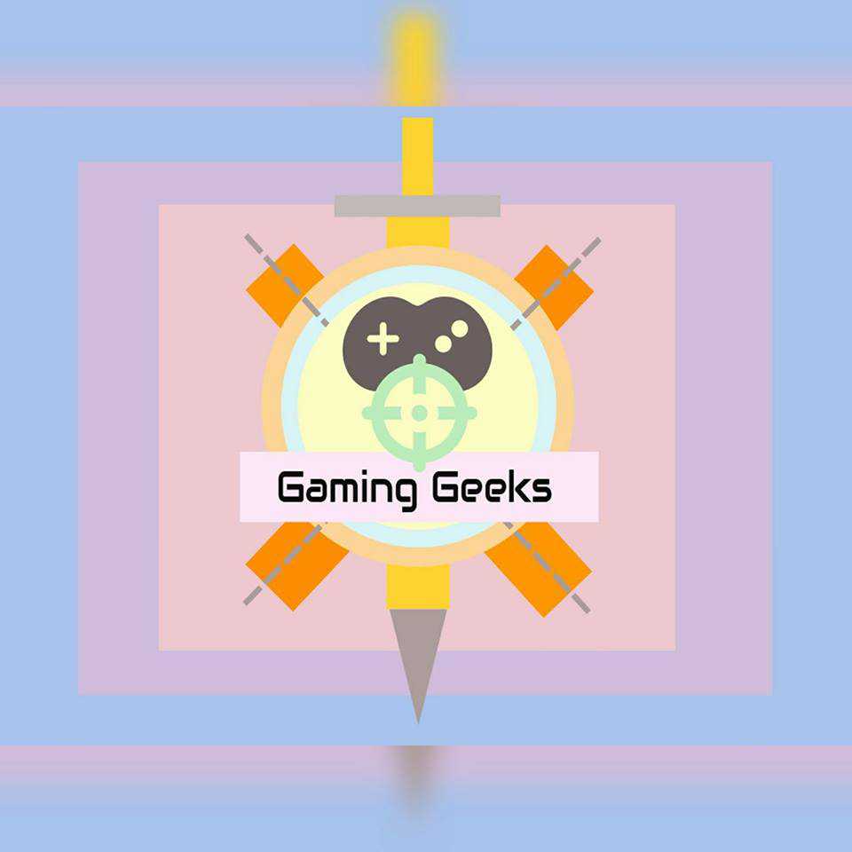
Ml Game Design
Using unity 3D Game engine

Slide 2
Introduction
In recent years, there have been significant advances in the state of Deep Reinforcement Learning research and algorithm design.
Essential to this rapid development has been the presence of challenging, easy to use, and scalable simulation platforms, such as the Arcade Learning Environment .
The existence of the Arcade Learning Environment (ALE), for example, which contained a set of fixed environments, was essential for providing a means of benchmarking the control-from-pixels approach of the Deep Q-Network . Similarly, other platforms have helped motivate research into more efficient and powerful algorithms.
These simulation platforms serve not only to enable algorithmic improvements, but also as a starting point for training models which may subsequently be deployed in the real world.
A prime example of this is the work being done to train autonomous robots within a simulator, and transfer that model to a real-world robot (OpenAI 2018). In these cases, the simulator provides a safe, controlled, and accelerated training environment.

Slide 3
Introduction
As the state of the field becomes more developed, existing environments and the benchmarks based on them become less informative, the need for novel environments presents itself.
For example, most environments in the Arcade Learning Environment have been solved well above human-level performance, making the continued use of the benchmark less valuable.
Many of the current research platforms described above are based on popular video games or game engines, such as Atari 2600, Quake III, Doom, and Minecraft.
This is part of a much longer-term trend in which games have served as a platform for Artificial Intelligence (AI) research. This trend can be traced back to the earliest work in AI around playing games such as chess and checkers, or work in the 1990s on applying Reinforcement Learning to the game of Backgammon.
The qualities found in many video games which make them engaging challenges for human players are also the same challenges which AI researchers are interested in themselves.
This insight has motivated a wide range of research into the intersection of video games and AI from the diverse perspectives of game playing, player modelling, as well as content generation.

Slide 4
Literature review
TOPIC : Path-finder Character with neural network brain.
OVERVIEW :
The Character is provided with an analogue control which has the value from -1(extreme left) to +1(extreme right).
Neural Network model is added, containing 5 inputs, couple of hidden layers and 1 output. The 5 inputs of the brain consists of Nodes namely Forward, Left, Right, Forward L and Forward R.
Training the NN is done using Reinforcement learning using Genetic Algorithms.

Slide 5
Requirements
Brain
Unity
Game Engine
3D Modelling
Software

Slide 6
Technology used
Unity Platform
Unity is a game development platform that consists of a game engine and graphical user interface called the Unity Editor. Unity was originally created in 2005 to enable developers to make video games and to help make the video game Goo Ball. Since then, Unity has grown and is now used by a large community of game developers to make a variety of interactive simulations, ranging from small mobile and browser-based games to high-budget console games and AR/VR experiences. This historical focus on developing a general-purpose engine to support a variety of platforms, developer experience levels, and game types make the Unity engine an ideal simulation platform.
The ﬂexibility of the underlying engine makes everything from simple grid world problems to complex strategy games, physics-based puzzles, or multi-agent competitive games possible. Unlike many of the research platforms deﬁned above, the underlying engine is not restricted to any speciﬁc genre of gameplay or simulation. Furthermore, the Unity Editor enables rapid prototyping and development of games and simulation environments.

Slide 7
Technology used
Unity Terminology
A Unity Project consists of a collection of Assets. These typically correspond to ﬁles within the Project. Scenes are a special type of Asset which deﬁne the environment or level of a Project.
Scenes contain a deﬁnition of a hierarchical composition of Game Objects, which correspond to the actual objects, either physical or purely logical, within the environment. The behaviour and function of each Game Object is determined by the components attached to it.
There are a variety of built-in components provided with the Unity Editor, including Cameras, Meshes, Renderers, Rigid Bodies, and many others. It is also possible to deﬁne custom components using C# scripts or external plugins.

Slide 8
Technology used
The ML-Agents toolkit is an open source project which enables researchers and developers to create simulation environments using the Unity Editor and interact with them using a Python API. The toolkit is built to take full advantage of the properties of the Unity Engine described above which make it a potentially strong research platform. The toolkit provides a set of core and additional functionalities.
The core functionality enables developers and researchers to deﬁne environments with the Unity Editor and associated C# scripts, and then expose these built environments to a straightforward Python API for interaction. Additional functionality includes a set of example environments and baseline algorithms.
The example environments can be used either as a means of benchmarking Reinforcement Learning algorithms, or as templates upon which to build or modify novel environments and control challenges for ML systems. The baseline algorithms can be used to train agents within any environment created using the core platform, and serve as a starting point for those interested in developing more advanced algorithms.

Slide 9
Thank You

